Slide 1
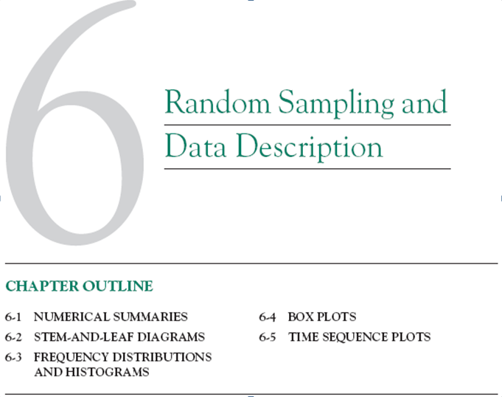

Slide 2
1. The pH of a solution is measured eight times by one operator using the same instrument. She obtains the following data: 7.15, 7.20, 7.18, 7.19, 7.21, 7.20, 7.16, and 7.18. Calculate the sample range, mean and standard deviation.

Slide 3
2.
90, 81, 78, 83, 68, 75, 79, 81, 69, 87, 76, 91, 67, 73, 81
Construct a stem and leaf diagram for these data.

Slide 4
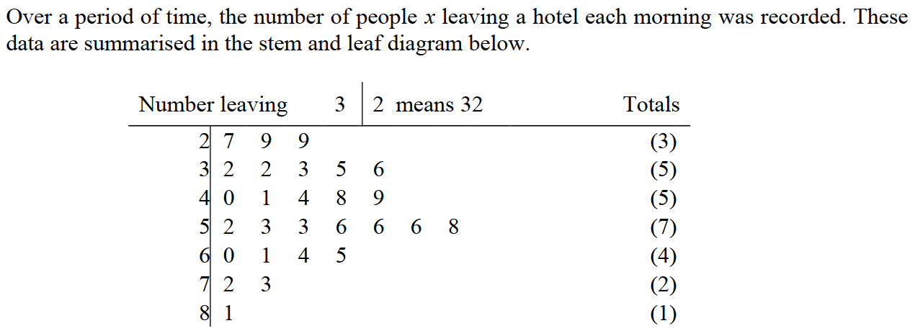

3.

Slide 5
4.

Slide 6
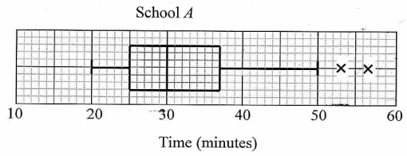




5.

